Slide 1
Alpha Sprint summary report
---reporter：Siqi Lin
Second-hand rental platform------G 1 THEMIS

Slide 2
01
02
03
TARGET
RESULT
GAIN
The plan before the Alpha Sprint started
The result of the Alpha dash
Summary of the group's overall gains

Slide 3
TARGET!
THEMIS development plan

Slide 4
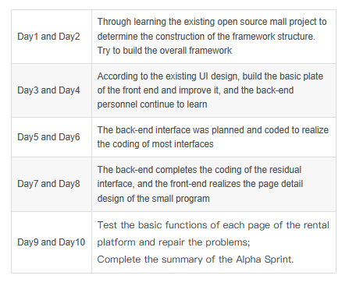
Alpha Sprint Plan!

Slide 5
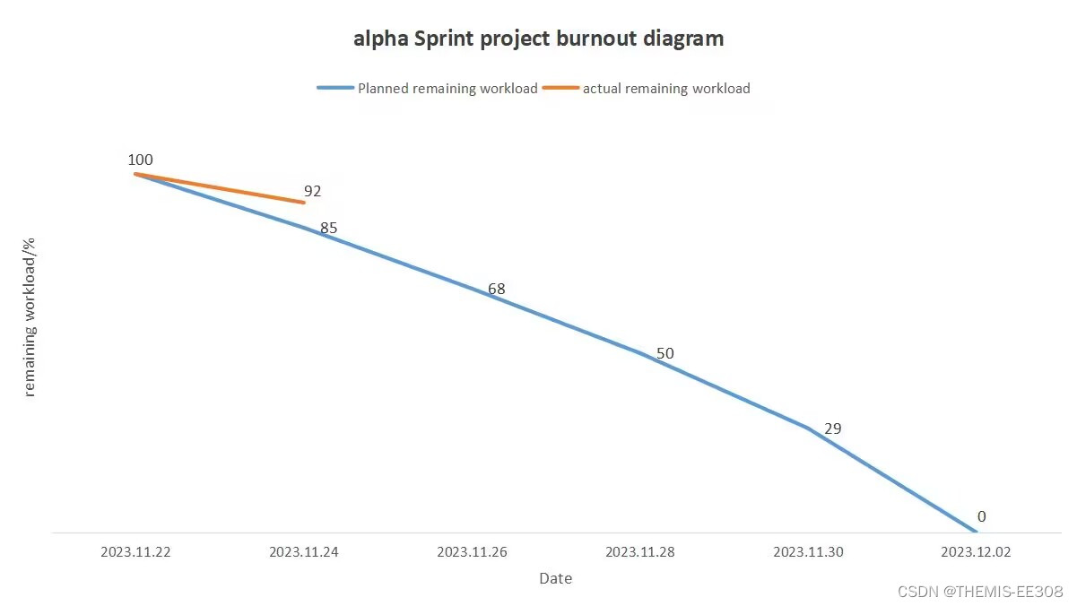
Period One
Found and downloaded appropriate UI component materials for some pages; The general front-end framework is built, and changes will be made according to the actual situation Completed the detailed coding of some pages;

Slide 6
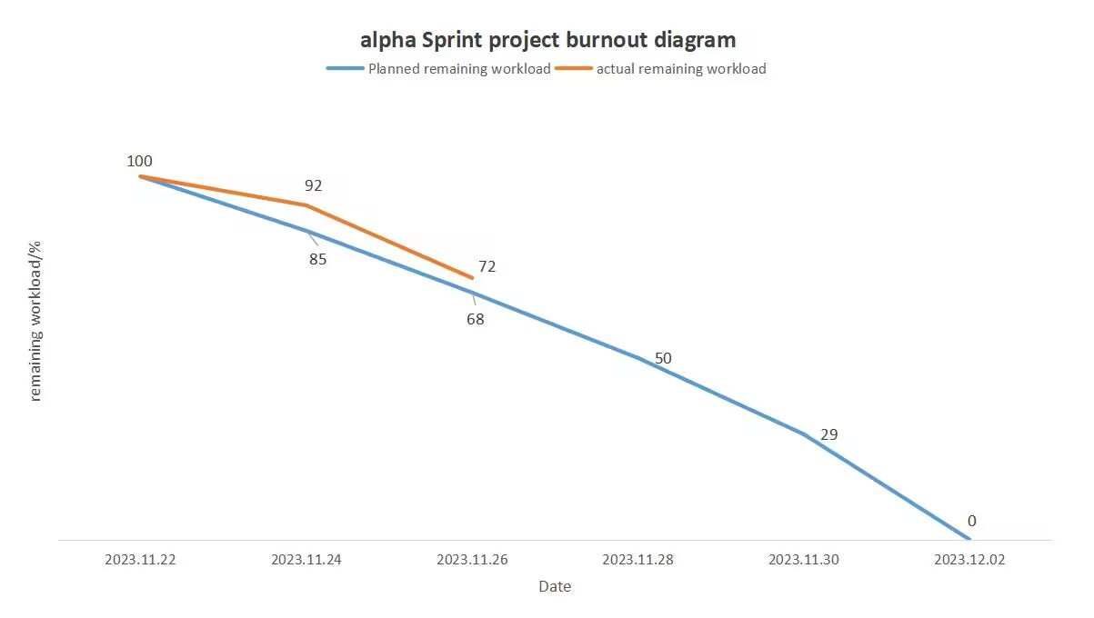
Period Two
Import some open source libraries (baomidou to encrypt information and some code libraries within org for easy programming) Created some parameter classes and encapsulated them for use in subsequent projects. Data output function; Product information Modifies the function of the module.

Slide 7
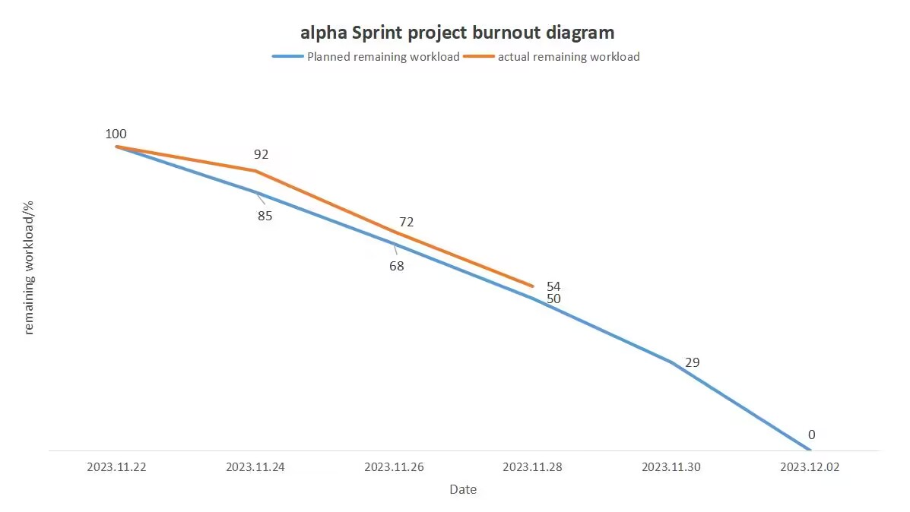
Period Three
Supplement the detailed layout of three pages; Added text information for some pages; Build and code the back-end interface of wechat users;

Slide 8
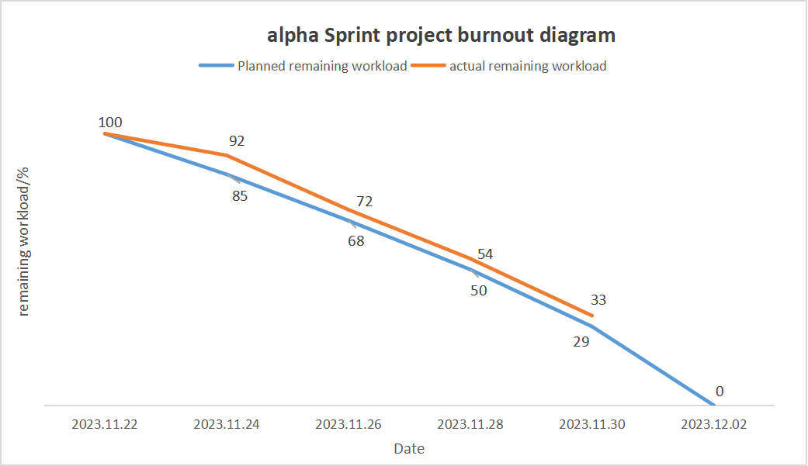
Period Four
Front end’s task: Implement the remaining pages, and all pages connected to the back end; Realization of the front-end design of the registration page; Realization of the front-end design of the retrieval, information editing and details pages for unused items; Front-end design for the password change page; Front-end design of the page for modifying user information; Front-end design of the page for quick release of products;
Back end’s task:
Implement the back-end processing of the order class;
Realize the back-end processing of product picture update;
Implement back-end processing of error reporting in special cases;
Implement the back-end code processing of shopping cart;
Minor bug fixes for written code interfaces and additions to real classes;

Slide 9
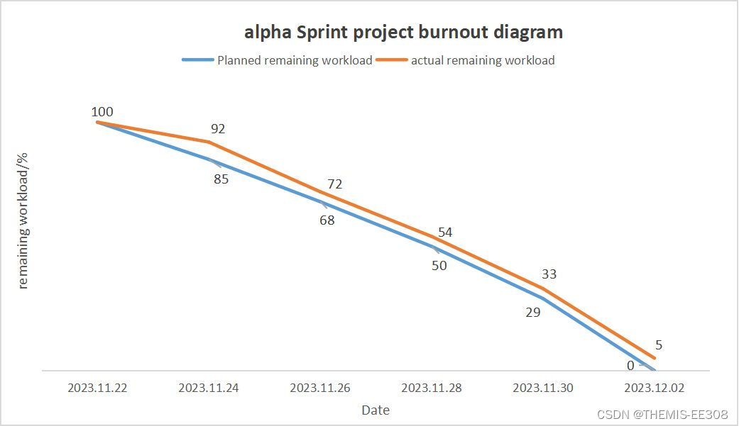
Period Five
Complete the port development required for the remaining pages and debug between the front and back ends； Consolidate all mysql data lists and delete redundant data tables；

Slide 10
Summary
UI
Front end
Back end
The page design that can be realized at present is designed
It realizes the page layout, jump and button interaction required by UI
The back-end interface and information flow processing are realized. There are also database data list creation

Slide 11

Future Expectations

Slide 12
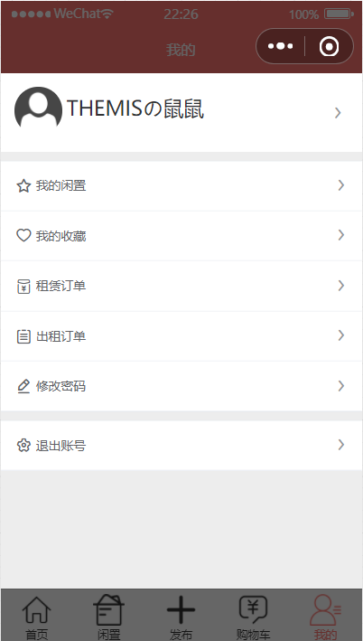
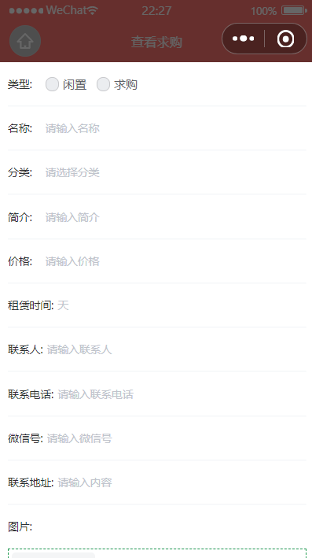
MOBILE WEB
More user-friendly UI interaction interface Including updates to fonts and interactive buttons.
Complete the corresponding interface of self-help Q&A to facilitate new users to quickly solve questions

Slide 13
THANKS FOR LISTENING AND BRING FORWARD OPINIONS

